Slide 1

Seven Lakes FFA
Livestock Raisers Meeting

Slide 2
Join the FFA Booster Club
All activities directly support FFA students
Scholarship Opportunities
Animal Pen Signs for livestock shows
Donate supplies to the FFA chapter
Financially assist the FFA chapter with various events during the school year
Follow us on:
  Facebook: https://www.facebook.com/people/Seven-Lakes-FFA-Booster-Club
  Website: https://www.sevenlakesffaboosterclub.com/

Slide 3

What is the Katy ISD Livestock Show?
Opportunity for FFA members to purchase, raise, show and then sell a livestock project.

Slide 4
Katy ISD Exhibitor Handbook 2023-2024
Livestock Show Exhibitor Handbook.pdf (google.com)
CTSO Handbook will be emailed via HAC.
Student and Parent/Guardian must read and sign an Acknowledgement Form
  Forms are due back to an Advisor by 9/15/2023.

Slide 5

What can they purchase, raise, show, and sell?
Rabbits
Broilers(Chickens)
Lambs
Goats
Pigs
Steers(Already in Progress)
Horticulture Plants
Floral challenge entry

Slide 6
Horticulture Show
$160 + $25 entry = $185
Given 12 plants in a lot. May purchase 2 lots
Must show at least 3 of those plants in your display
Display may include anything pertaining to the rodeo theme (tbd)
Display can NOT utilize power from an onsite electrical source.
Grand and Reserve Champion will be selected.
Grand will receive $2000 premium. Reserve will receive $1000 premium.
All others displays will be entered into barn sale for $30. WILL BE ELIGIBLE FOR ADD ON’s.
Must meet all show requirements – fund raising, creed, ect.

Slide 7
Katy ISD FFA Livestock Show and Rodeo Auction
155 live auction lots (33 added spots from 2023)
  Rabbits – 15 Sale Spots – Includes G/R Showmanship
  Broilers – 10 Sale Spots – Includes G/R Showmanship
  Steers – Top 3 in Each Class Sale + 2 G/R + 2 G/R Showmanship
  Hogs – 54 Sale Spots – 10 Classes – Top 5 Sell + 2 G/R + G/R Showmanship
  Lambs - 29 Sale Spots – 5 Classes – Top 5 Sell + 2 G/R + G/R Showmanship
  Goat – 34 Sale Spots – 6 Classes – Top 5 Sell + 2 G/R + G/R Showmanship
    If Grand/Reserve/Showman are pulled from a class – the next highest-ranking animal from that class bumps into sale.
Buyers
    Not guaranteed.
    Work to get them there to support YOU.

Slide 8
What is required of the student?
Be an FFA Member
Attend monthly meetings
Sell $500 or more of Fundraising
  At least one Catalog Ad
  RiverStar (Fruit and Meat)
10 hours of community service
KISD Livestock Dress Code
Maintain a Record Book
Participate in 2 above the chapter level activities
Complete Quality Counts
Recite FFA Creed

Slide 9

Where are we going to keep this animal?
At the Ag Barn
Pigs
Lambs
Goats
Steers
At Your House
Rabbits
Broilers
Horticulture projects\

Slide 10
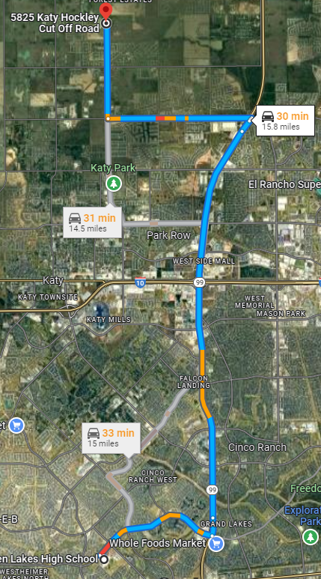
Where is the Ag Barn?
5825 Katy-Hockley Cut-Off Road Katy, TX 77493
Barn Bus -
  Morning only, no p.m.
  Pick up behind the school
  by the cafeteria
  Will give more info as we
  have it (timing)

Slide 11
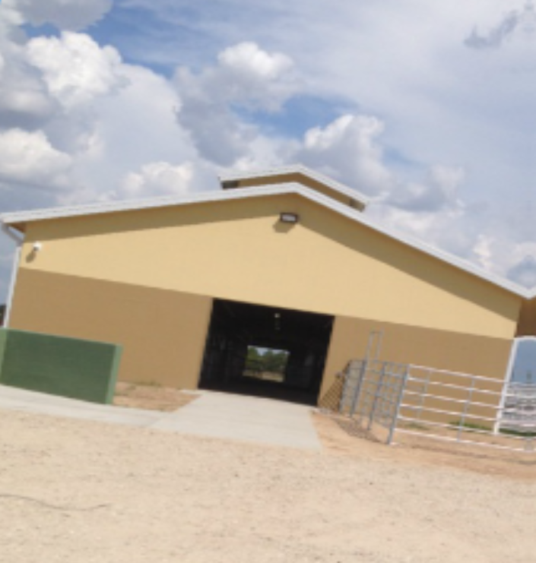
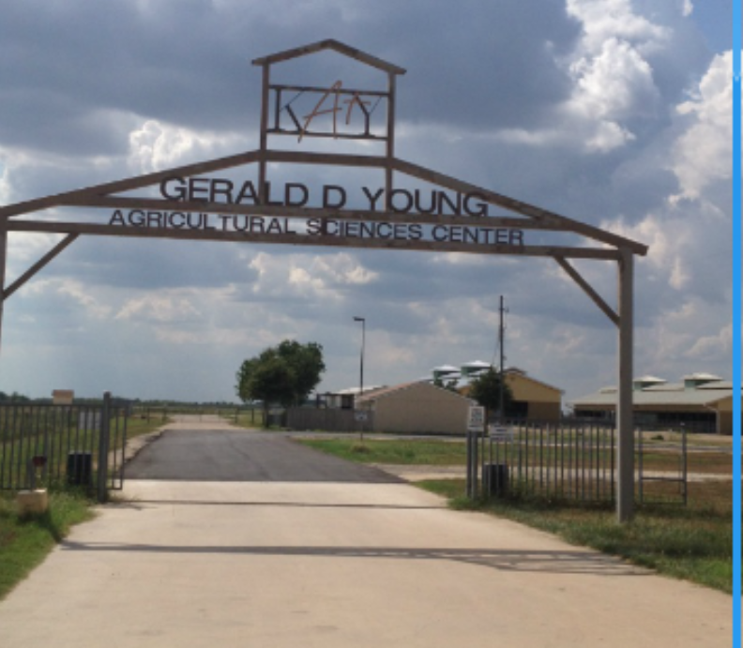
Ag Barn
(Barn # 1)

Slide 12
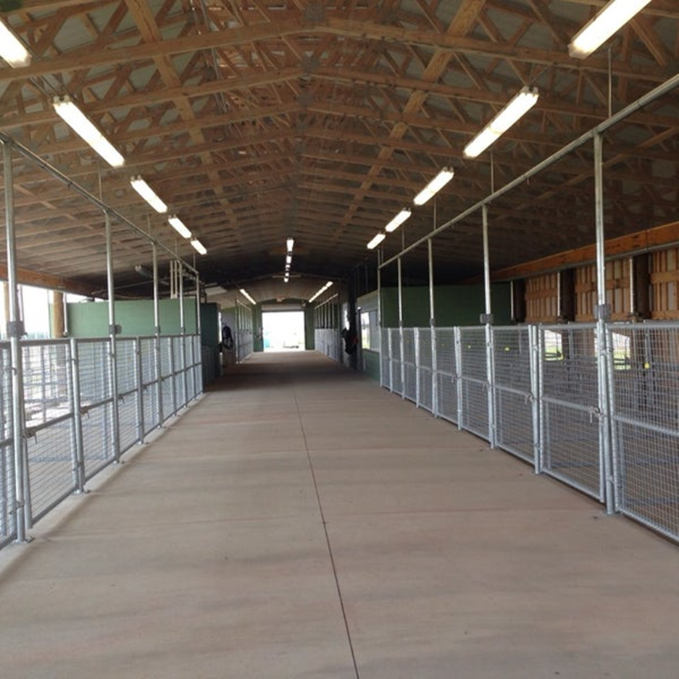
Ag Barn
(Barn #1)

Slide 13
Barn Rules
If you bring a visitor, they are your responsibility – that means if their actions could result in YOU being disciplined.
Barn is School property – dress code and tobacco policy applies
No pets

Slide 14
Barn Rules Cont.
Students and parents enter barn through Katy-Hockley Cut Off (Main Gate)
ALL barn visitors are to park in the Katy-Hockley parking lot.
NO EXCEPTIONS – NO UNLOADING IN BACK OF BARNS!!!
OBEY POSTED SPEED – 15 MPH

Slide 15
Barn Rules Cont.
Must have Student ID at all times.
Pens will be assigned based on seniority and species.
  Sole discretion of Advisors
STAY IN OUR BARN.

Slide 16
Barn Rules Cont.
We have been directed to pay close attention to animal welfare. If we suspect, you are not feeding your animal or pen is obviously unkept we will be utilizing the 3 Offenses Rule & Removal.
If there is an issue with the barn after hours or weekends call KISD Police 281-237-4000
Call FFA Advisors as well.

Slide 17
Barn Rules Cont.
All request for repairs must be made to AST via e-mail request. We need to have documentation.
ALL FEEDERS ARE TO SWEEP THE AREA DIRECTLY IN FRONT OF THEIR PEN EVERYDAY!
Check the duty chart!!!

Slide 18
Duty Calendar
There will be a chore calendar posted at the barn. Students will be expected to complete those chores on a weekly basis. AST will check for compliance each Monday. Failure to complete will result in financial penalties assessed at the completion of project.
$50 fine

Slide 19
We have an AMAZING FACILITY. We must treat it as such! PRIDE!!!
1st Offense: The student will receive a letter from the AST, which constitutes a warning, and the problem must be remedied within two days of letter’s date to the satisfaction of the AST. The letter will be signed by both the student and the parent and filed in the CTE office of KISD. A copy of the letter will be made available to the campus administrator of the student.
2nd Offense: Same as above – will be considered a final warning.
3rd Offense: Student will be evicted from the facility and the animal will be removed from the premises at the owner’s expense.

Slide 20
Dr. Moore
Veterinarian
Will travel to the barn to treat animals
979-251-1151
If you contact Dr. Moore to check your animal, you are responsible for all charges. You are to pay him immediately or arrange payment options with him. NO BILLING WILL BE COVERED BY SEVEN LAKES FFA.

Slide 21
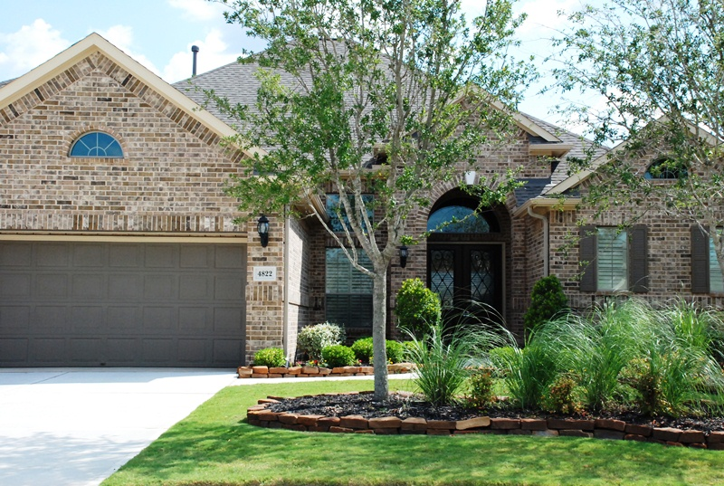
Broiler Facilities

Slide 22
Rabbit Facilities

Slide 23
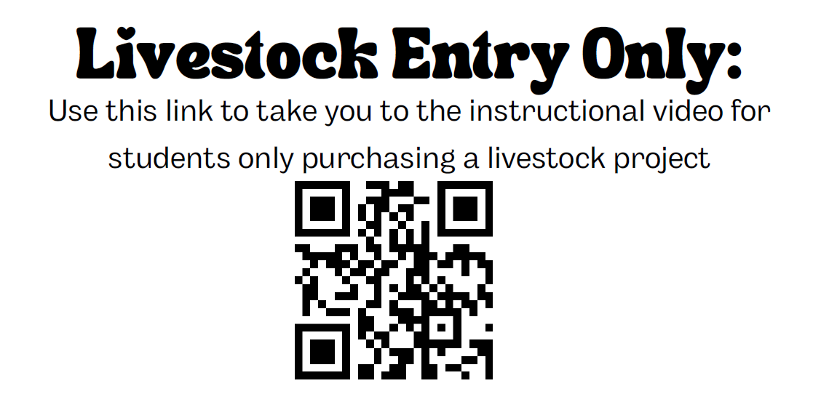

Slide 24
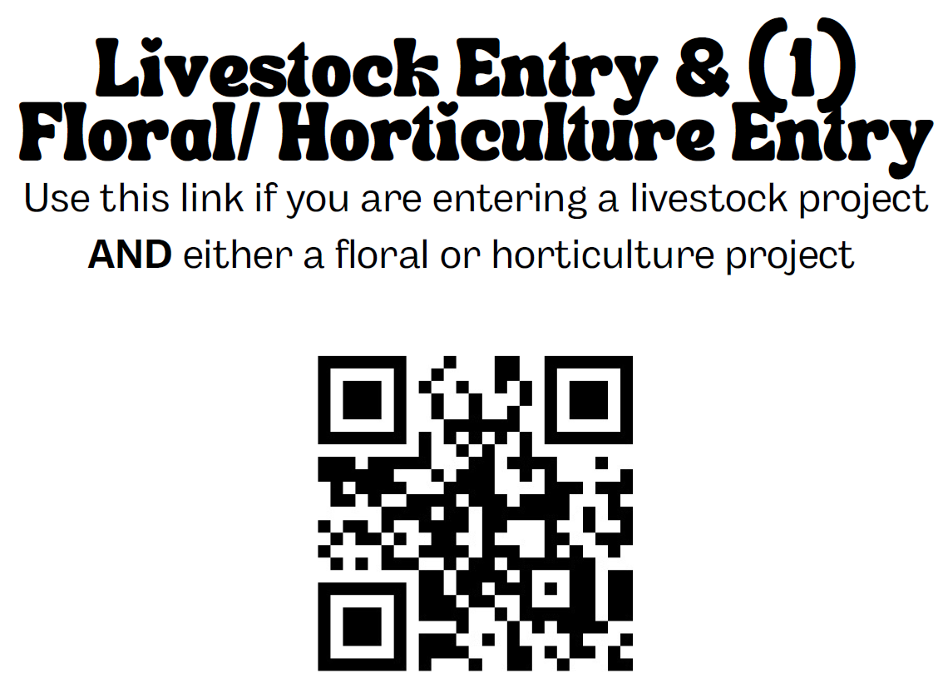

Slide 25
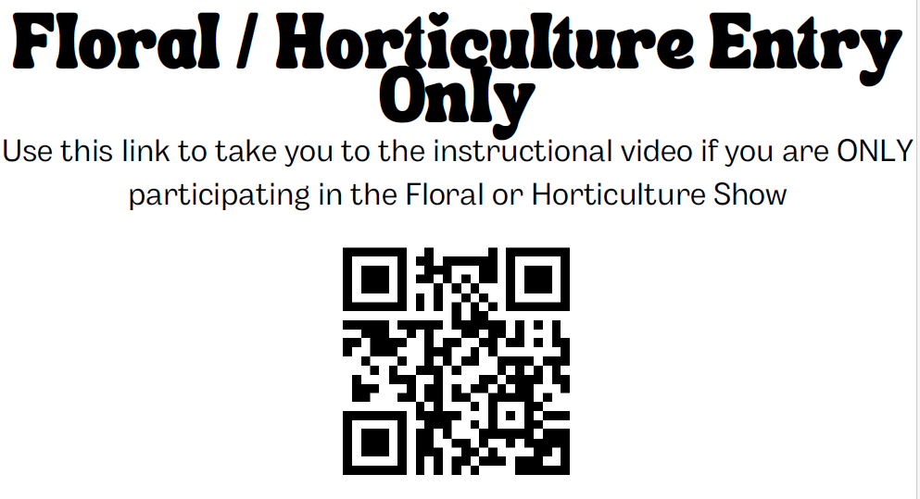

Slide 26
How Much Does it Cost?
Animal | Cost | Entry Fee | Pen Rent | Barn Keys | Rotary Scholarship | Calf Scramble | Total Cost (Due Now) | Approx Feed/Supplies
Steer | $ 2,000.00 | $ 25.00 | $ 180.00 | $5.00/each | Fund Amount TBD | Must have caught at the 2023 Katy ISD Rodeo | $ 2,215.00 | $3,000.00
Hog | $ 400.00 | $ 25.00 | $ 80.00 | $5.00/each |  |  | $ 515.00 | $1,200.00
Lamb | $ 500.00 | $ 25.00 | $ 80.00 | $5.00/each |  |  | $ 615.00 | $800.00
Goat | $ 500.00 | $ 25.00 | $ 80.00 | $5.00/each |  |  | $ 615.00 | $800.00
Rabbits | $ 250.00 - 300.00 | $ 25.00 |  |  |  |  | $ 25.00 | $500.00
Broilers | $ 37.50 - 100.00 | $ 25.00 |  |  |  |  | $ 25.00 | $500.00
Horticulture | $ 160.00 | $ 25.00 |  |  |  |  | $ 185.00 | $400.00
Floral Contest | $ 150.00 | $ 25.00 |  |  |  |  | $ 175.00

Slide 27
Now What?
Fill Out the Online Registration Form to Register and Pay for an animal or plant show. You can show 1 animal and 1 non-animal project (Horticulture or Floral)
  Must be completed between September 7th–15th
  If you do not register, you do not show! No exceptions!
  Takes Discover, MasterCard, Visa, debit, or e-check
W-9 Form will be a part of the registration process
If you do not pay by September 15th at 11:30pm, you will not show!

Slide 28
Number Draw
10/6/2023
3:00PM-4:00PM
Show Arena at the Ag Science Center
Exhibitors will draw their number for selection.
Exhibitors arriving after 4:00 PM will draw their number ten (10) minutes before their school starts their scheduled preview time.
If a student cannot make the drawing of numbers, the AST will draw for the student.

Slide 29
Animal Preview
L.D. Robinson Pavilion
Seven Lakes FFA Preview Time:
  6:00 PM - 6:30 PM
Student and 1 Parent can Preview
  No siblings, no fitters, no coaches
Bring Pen and Paper to make list

Slide 30
Animal Selection
October 7, 2023
  Barns Open to Exhibitors at 7:00AM
    Hogs – 7:30 AM
    Goats – 11:00 AM
    Lambs – 1:00 PM

Slide 31
2024 Katy ISD FFA Livestock Show Schedule
Tuesday 2/13/2024
  9:00 AM - Best Buddies Grand Drive
  10:00 AM – Special Rodeo
  3:30 PM – All Lamb, Goat, Swine must be in place
  4:00 PM - 5:30PM - Swine Weigh-in
  6:00 PM - Broiler Show
  8:00 PM - Barn Closes

Slide 32
2024 Katy ISD FFA Livestock Show Schedule
Wednesday 2/14/2024
  8:00 AM - Broiler Barn Sale Opens
  8:00 AM - Horticulture books/logs turned in
  8:00 AM – 12:00 PM – Art Show Set Up
  9:00 AM – Floral Contest
  10:00 AM - Horticulture Show
  1:00 PM - Art Show
  2:00 PM - Rabbit Show
  4:00 PM – 5:30 PM - Goat and Lamb Weigh-In

Slide 33
2024 Katy ISD FFA Livestock Show Schedule
Thursday 2/15/2024
  8:00 AM - Rabbit Barn Sale Opens
  8:00 AM – Swine Show
  1:00 PM – Steer Show
  2:00 PM - Ag Mechanics Show
  4:00 PM - Swine Barn Sale Opens
  5:00 PM - Art Show Awards
  7:00 PM - Rodeo Performance
  8:00 PM - Barn Closes

Slide 34
2024 Katy ISD FFA Livestock Show Schedule
Friday 2/16/2024
  8:00 AM - Steer Barn Sale Opens
  8:00 AM – Goat Show
  10:00 AM – Lamb Show
    Goat/Lamb Barn Sale Opens 1 Hour after each show respectively
  1:00 PM - Auction Sales Meeting
  (Mandatory for ALL AUCTION PARTICIPANTS)
  7:00 PM - Rodeo Performance
  8:00 PM - Barn Closes

Slide 35
2024 Katy ISD FFA Livestock Show Schedule
Saturday 2/17/2024
  7:00 AM - Greenhand Ceremony
  9:30 AM - Parade
  11:00 AM - Buyers’ Luncheon (Invite Only)
  1:00 PM - Auction
    Barn Sales/Add-Ons Close 1 hour after the Auction
  7:00 PM - Rodeo Performance

Slide 36
Join Seven Lakes FFA Remind!
Important Information is shared this way!
Text:
@7lakesFFA
to
81010

Slide 37
Join Seven Lakes Animal Raiser Remind!
**This is for ALL animal raisers!**
Text:
@7lakesbarn
to
81010

Slide 38


Follow us on our website,
Instagram and Facebook!
http://www.sevenlakesffa.ffanow.org
Instagram:
  @7lakesffa
Facebook:
  Seven Lakes FFA

Slide 39
2023-2024 Seven Lakes FFA Greenhand Members

Slide 40
Dates
Catalog Sale - 8/30/23 - 9/29/23
Species Meetings – 9/21/23 @ 2:35PM
  Pigs – 1315
  Broilers – 1315
  Horticulture 1315
  Rabbits – 1316
  Lambs – 1316
  Floral Contest – 1316
  Goats - 1311

Slide 41
Dates
Cinco Ranch Feeding Seminars – 9/18/23 6:30PM
  L.D. Robinson Pavilion
September Monthly Meeting – 9/20/23 6PM
  SLHS LGI – State Officer Visit
Barn Clean Up - 9/28/23 3PM
  Gerald D Young Ag Science Center – Barn 1
Homecoming Parade - 10/4/23
  More Info Come

Slide 42
Dates
Number Draw – 10/6 3PM
Animal Preview - 10/6 6-6:30PM
Animal Selection – 10/7
  Barn Opens – 7AM
  Pigs - 7:30AM
  Lambs - 11AM
  Goats - 1PM

Slide 43
Dates
Katy ISD Ag Olympics - 10/14 8AM
Katy ISD Leadership Camp - 10/16
Northwest District Greenhand Camp – 10/24
Meat/Fruit Sale Begins - 10/30
LDE Showcase - 10/30
District LDEs - 11/8-9
Meat/Fruit Sale End - 11/27

Slide 44
Dates
Katy ISD Progress Show - 12/7-8
Barn Clean Up - 12/12 3PM
7Lakes FFA Christmas Party - 12/12 5PM
Celebrity Showmanship - 1/2/24
Horticulture Plant Pick Up - 1/4/24
Broiler Pick Up - 1/4/24
Rabbit Tattooing - 1/11/24
Greenhand Jacket Ceremony - 1/22/24 6PM

Slide 45
Katy ISD FFA Livestock Show Requirements to Show

Slide 46
Must attend all scheduled FFA meetings unless otherwise cleared by AST. Calendar
Dress Code – Hair cuts/colors, facial hair, piercings, tattoos.
Students will maintain a record book. Will be doing most of this in their Ag class.

Slide 47
10 hrs community service – fundraisers, Special Rodeo, chapter activities TBD (calendar) MUST BE ENTERED IN RECORD BOOK
FFA Creed – due 12/12 Christmas Party/Barn Clean-up
Quality Counts – will be completing in Ag class due 12/8

Slide 48
Must participate in two activities above the chapter level – use your FFA calendar. MUST COMPLETE FALL
  Feed Management Workshop 9/18
  Ag Olympics 10/14
  Katy ISD Leadership Camp 10/16
  Dist. Greenhand Camp 10/24
  Join an LDE team and attend 5 practices
  LDE’s 11/8-9
  Progress Show 12/7-8

Slide 49
Chapter Fund Raising - $500. Catalog Ads and Meat/Fruit Sale
Buyout = $350
Earn their FFA jacket.
UIL Eligibility – Student must be academically eligible for the 3rd Six Weeks!!! Can regain on 4th Progress Report

Slide 50
Selection
Students' selection number is based on random drawing – Oct 6th 3-4PM. Show Pavilion. If you would like for us to pick for you tell your species AST.
Students and parents may preview animals during Preview. 6:00 – 6:30 pm, Oct 6th

Slide 51
Only students and AST are allowed in selection area during Selection. We will cover what to look for at species meetings.
AST will be there to help/assist members
AST will transport animals to Ag Barn at the CONCLUSION of selection

Slide 52
Katy ISD Progress Show
12/7-8/2023
AST will transport animals on 12/7
  Goat/Lamb Show 12/7 at 4pm
  Pigs/Steers Show 12/8 at 2pm
Opportunity for student to practice showing their animal
Students show in Progress Show t-shirt, jeans, boots/Sperry's
Booster Club sponsors a silent auction

Slide 53
Seven Lakes FFA
Celebrity Showmanship
Jan 2, 2024 11:00 – 3:00
Students ask one of their teachers to show their animal.
They meet with teacher and “train” them how to show.
Teachers then compete in a showmanship class. Winners receive a belt buckle.
This year we’re planning to have huge school turnout.

Slide 54
Katy ISD FFA Livestock
Show and Rodeo
Students exhibit animals in Official FFA Dress. FFA jacket, collared white shirt, FFA scarf/tie, black pants (dickies) NO BLING ON PANTS, black closed toed shoes/boots.
Students miss three days of school if they participate in all activities. It is an excused UIL absence. Attendance is taken in the morning and afternoon. Members missing are assessed a monetary fine.

Slide 55
Katy ISD FFA Livestock
Show and Rodeo
Students should be watching other students while showing and exhibit proper sportsmanship.
Students are encouraged to ride on the KISD float on Saturday morning in official dress.

Slide 56
Katy ISD FFA Livestock Show
Barn Sale
Barn Sale
  Animals that do not make Live Auction go into Barn Sale.
  Prices are a flat rate.
  Prices for Barn Sale Animals:
    Steers - $3000.00
    Lambs - $400.00
    Goats - $400.00
    Hogs - $500.00
    Broilers - $100.00
    Rabbits - $100.00

Slide 57
Katy ISD FFA Livestock Show
Add-Ons
Add-Ons are funds given to students
Anyone can give an Add-On
Can be given in-person and online

Slide 58
After The Show
Clean your barn pen. Due 3/1 $25/day
Deliver Rabbits/Broilers. Due 3/1 $25/day
Live auction = Picture Delivery. Due 4/1 $25/day
All sellers = Thank you Letters. Due 4/1 $25/day

Slide 59
Ag Science Teacher Contact Info
Mr. Bochat – JosephHBochat@katyisd.org 281-642-1231
Mr. Godwin – MatthewBGodwin@katyisd.org 903-681-2817
Mrs. Sheffield – KatySheffield@katyisd.org 281-793-5233
Ms. Ognoskie – MorganOgnoskie@katyisd.org 281-743-7356

